Slide 1
Student Attendance System
Name : A Kowshik
Reg no: 43612024

Slide 2


Abstract
The Student Attendance Management System is a Java Full Stack project designed to simplify and automate attendance tracking for students. It enables users to add students, mark attendance, and calculate attendance percentages efficiently. This project aims to eliminate manual errors, save time, and provide accurate attendance data management.

Slide 3

Existing System
In the existing manual system, attendance is recorded on paper or spreadsheets. This leads to data redundancy, misplacement of records, and difficulty in calculating attendance percentages. There is no automated method to check individual student reports, making the process time-consuming and error-prone.

Slide 4

Proposed System
The proposed system is a fully digital Java Full Stack web application that allows administrators to manage student details and mark attendance online. It provides real-time tracking of attendance, automatic percentage calculation, and a search feature for quick report access. The system improves efficiency, accuracy, and accessibility.

Slide 5

Advantages
✔ Eliminates manual record-keeping errors. ✔ Saves time and increases productivity. ✔ Real-time attendance management and report generation. ✔ Easy to access and update student information. ✔ Secure and reliable database storage.

Slide 6
Disadvantages
✖ Requires internet connectivity for online access.
✖ Initial setup and database configuration take time.
✖ Requires training for new users unfamiliar with web systems.

Slide 7

Hardware Requirements
• Processor: Intel i3 or higher
• RAM: Minimum 4 GB
• Hard Disk: 250 GB or more
• Display: 1024x768 resolution monitor

Slide 8

Software Requirements
• Frontend: HTML, CSS, JavaScript
• Backend: Java, Spring Boot
• Database: MySQL
• IDE: IntelliJ IDEA / Eclipse
• Web Server: Apache Tomcat
• Tools: Maven, Postman

Slide 9

Modules
1. Student Module
2. Attendance Module
3. Report Module
4. Authentication Module (Optional)

Slide 10
Module Description
1️⃣ Student Module – Add and manage student details such as name, registration number, email, department, and year. 2️⃣ Attendance Module – Mark students as present or absent for each session. 3️⃣ Report Module – Generate detailed reports showing total classes, presents, absents, and attendance percentage. 4️⃣ Authentication Module – Provides secure admin login for managing attendance.

Slide 11
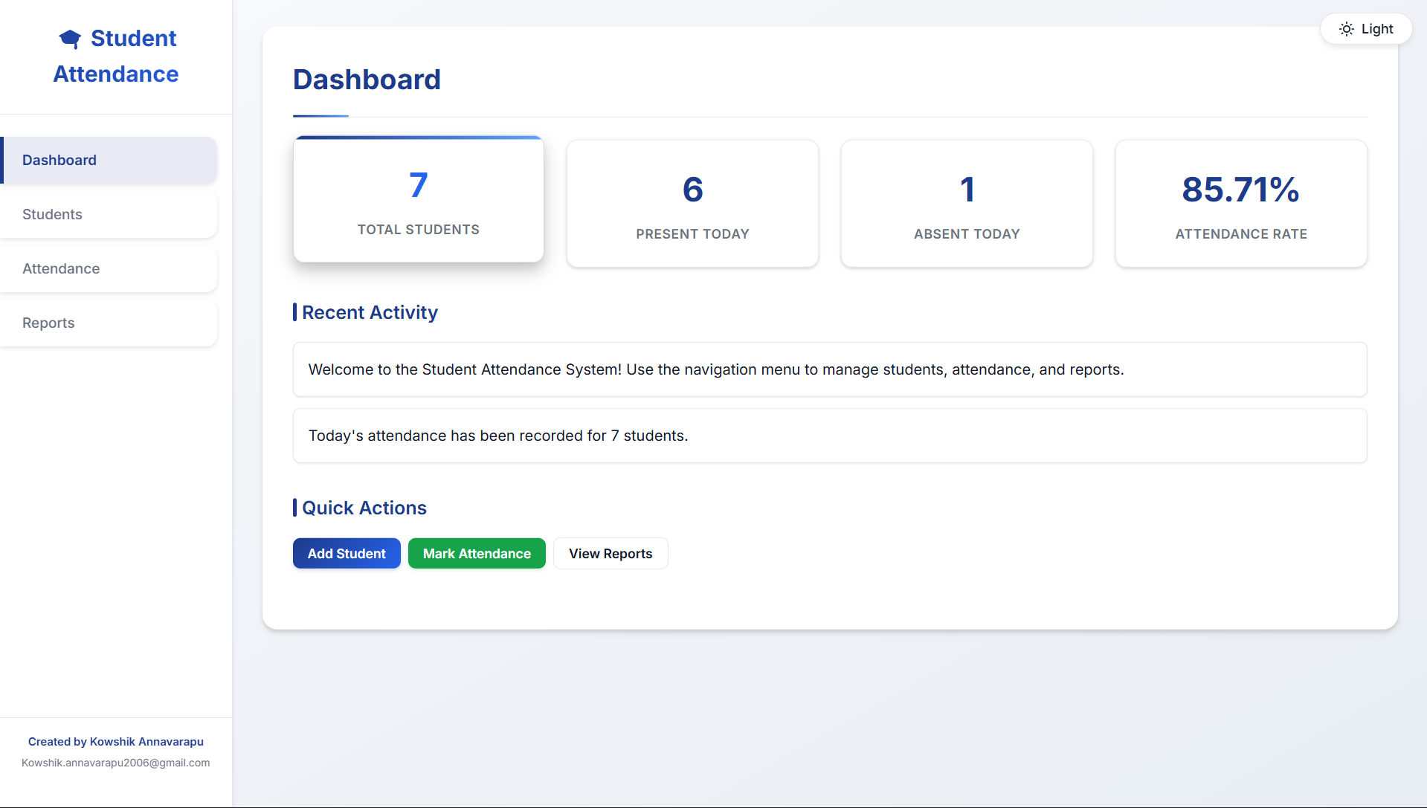
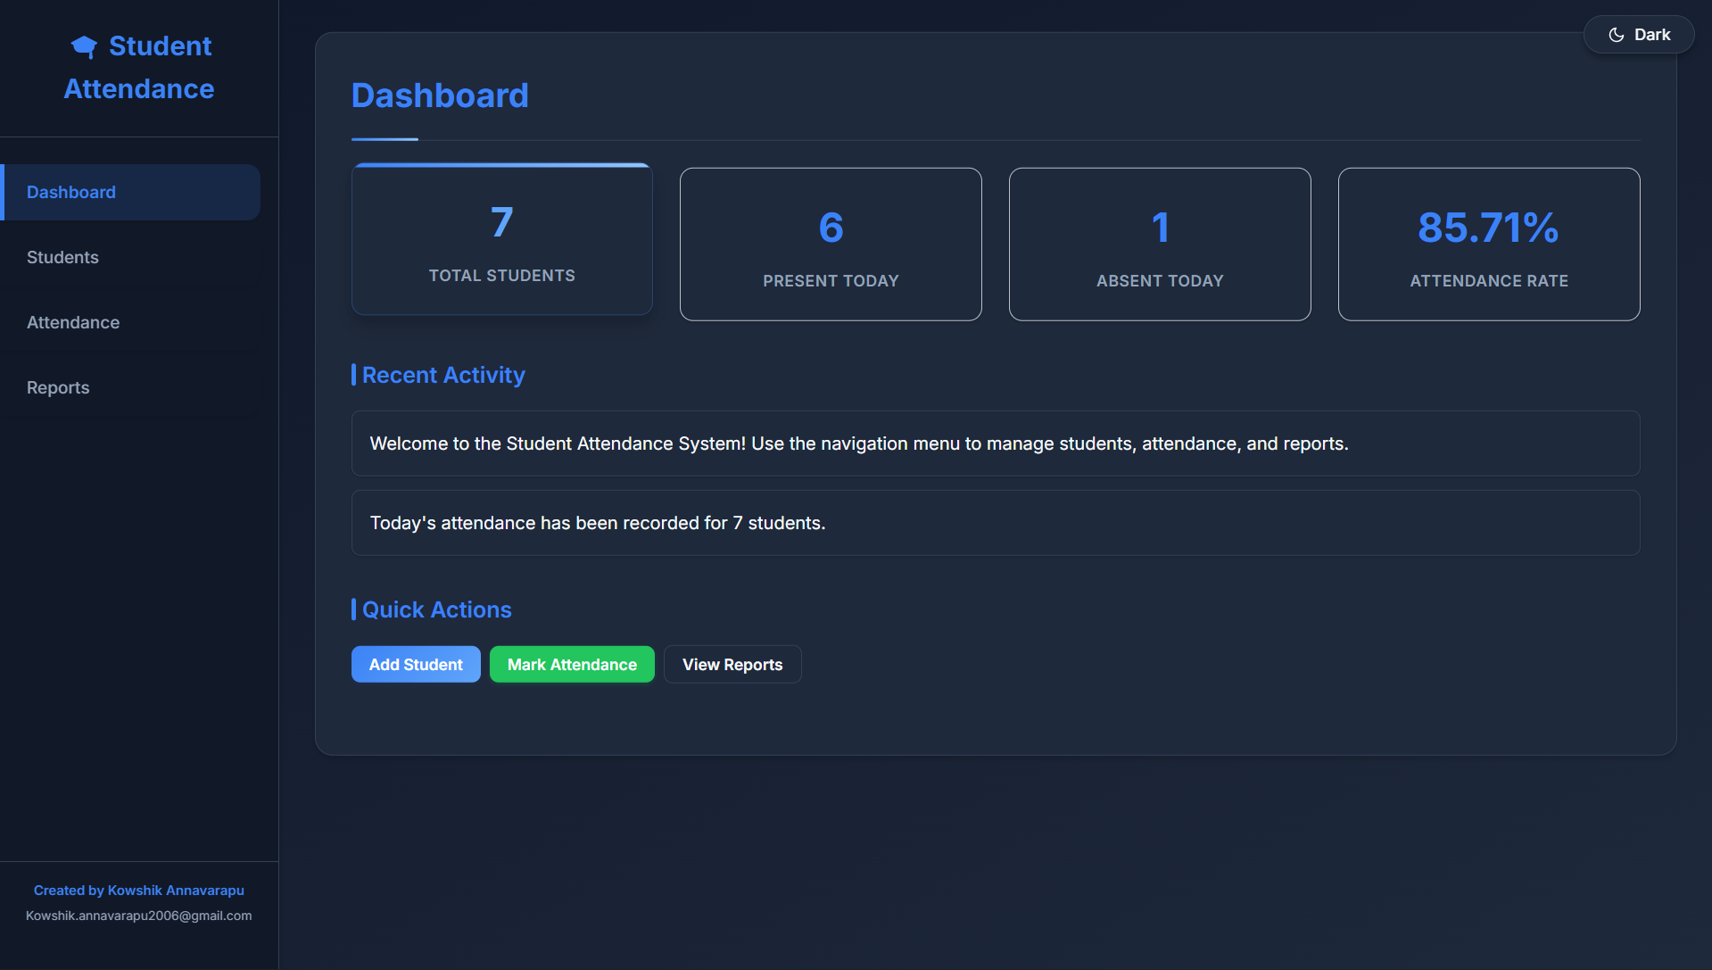
Sample Output:

Slide 12

Conclusion
The Java Full Stack Student Attendance Management System is an efficient and reliable solution for modern institutions. It simplifies attendance management, ensures accuracy, and enhances productivity. By automating attendance tracking, it contributes to smoother academic administration and better data insights.

